Slide 1

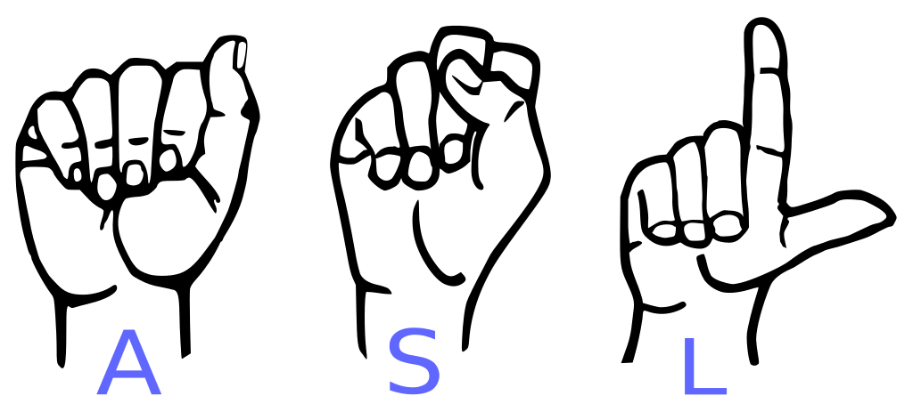
Final Project Presentation
Group 3
ASL Duolingo
Notes:
Mike

Slide 2
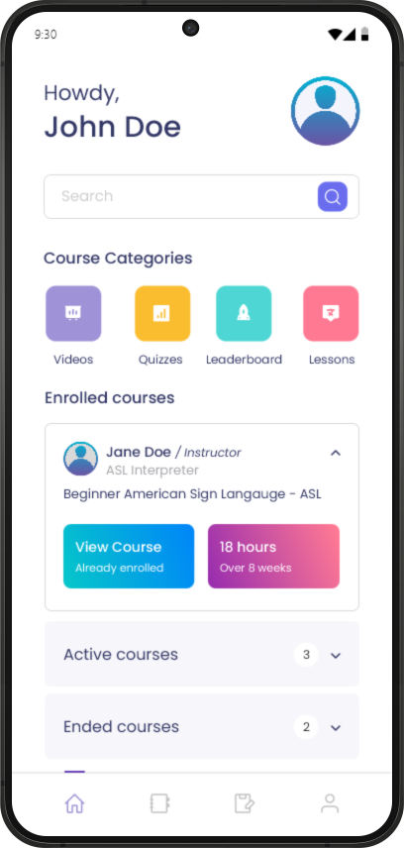
Introduction
App similar in concept to Duolingo, but for the ASL community
Social and Collaborative features to the learning community
Fosters healthy competition between students about learning
Notes:
Mike

Slide 3
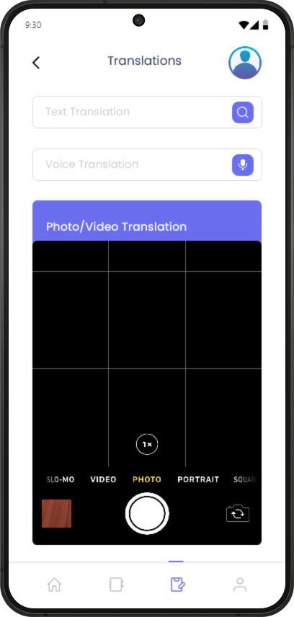
Gesture Recognition and ASL Pronunciation Practice - Feature 1
Advanced technology is used to analyze hand gestures and provide immediate feedback on accuracy
Helps users practice ASL in a practical interactive way, improving retention and fluency
Encourages mastery of proper singing techniques through repetition and correction
Notes:
Mike

Slide 4
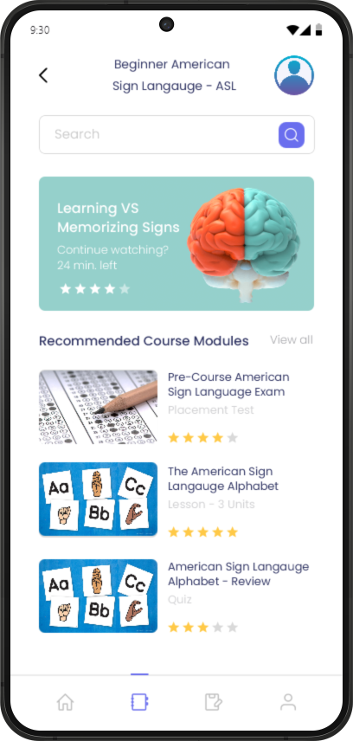
Adaptive Learning Pathways - Feature 2
Starts users at the right proficiency level based on a placement test
Dynamically adjusts lesson difficulty based on user performance and learning pace
Provides personalized goals to keep users engaged and steadily progressing
Notes:
Mike

Slide 5
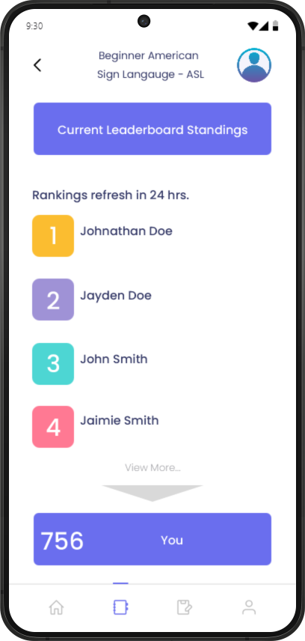
Social and Gamified Learning - Feature 3
Leaderboards encourage friendly competition among users to improve their rankings.
Gamified elements like badges, points, and streaks keep users motivated and reward consistency.
Social features like adding friends and sharing progress promote collaboration and accountability.
Notes:
Albert

Slide 6
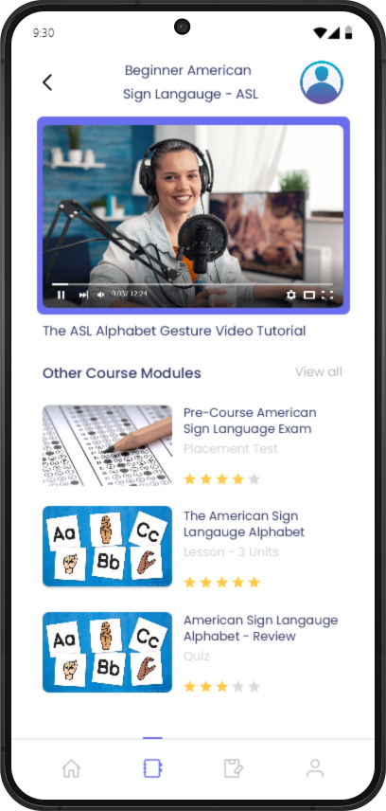
Video Demonstrations and Context-Based Lessons - Feature 4
Offers real-world examples of ASL usage through high-quality video demonstrations.
Focuses on context-driven scenarios to help users apply ASL in everyday situations.
Includes lessons designed by ASL experts to ensure cultural and linguistic accuracy.
Notes:
Albert

Slide 7
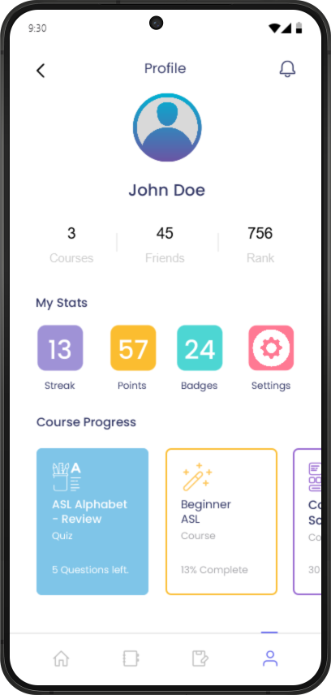
Comprehensive Progress Tracking and Rewards - Feature 5
Tracks individual achievements with detailed reports and summaries.
Daily streaks and reminders encourage consistent learning habits.
Milestone rewards celebrate progress, motivating users to reach the next level.
Notes:
Albert

Slide 8
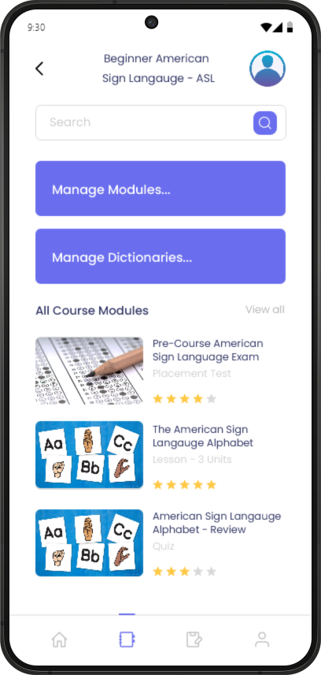
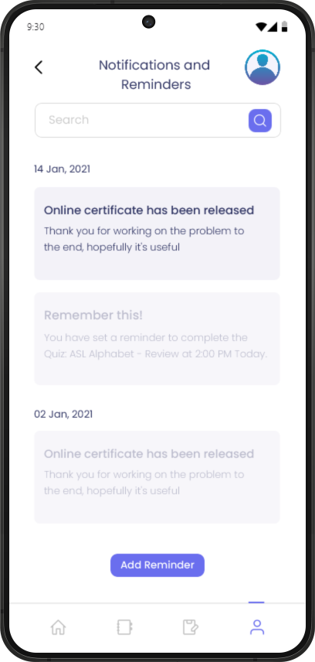
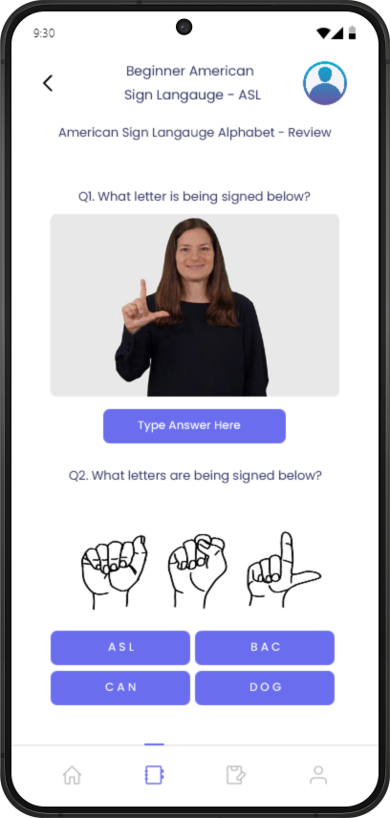
Other Important Features
Notes:
Ryan
3 Extra Features, Admin/Instructor Dashboard, Student Reminders, Student Quizzes to test knowledge.

Slide 9
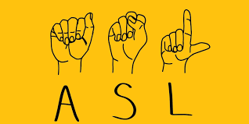
Accurate Gesture Recognition - Challenge 1
Problem: Ensuring the app reliably detects and evaluates diverse hand shapes, movements, and gestures across varying lighting conditions and backgrounds.
Solution: Incorporate machine learning models trained on extensive datasets of ASL gestures under different environments. Use device-specific optimizations and allow manual override options for ambiguous cases.
Notes:
Ryan

Slide 10
Personalized Adaptive Learning - Challenge 2
Problem: Developing a robust adaptive learning algorithm that effectively tailors lessons to the user’s proficiency and progress.
Solution: Implement an AI-driven recommendation system that uses user performance metrics to dynamically adjust content difficulty and offer targeted reviews of weak areas.
Notes:
Ryan

Slide 11

Maintaining Engagement Over Time - Challenge 3
Problem: Users may lose motivation due to repetitive content or lack of variety in activities.
Solution: Regularly update lesson modules with fresh content, add seasonal challenges or themes, and introduce multiplayer activities for interactive learning experiences.
Notes:
Matt

Slide 12
Comprehensive Resource Management - Challenge 4
Problem: Managing and curating a vast dictionary of ASL and English terms, along with video demonstrations and lessons, can be resource-intensive.
Solution: Use cloud-based storage and content delivery networks (CDNs) to efficiently manage and distribute resources. Implement user feedback mechanisms to prioritize updates and identify errors efficiently.
Notes:
Matt

Slide 13

Inclusive Design for Diverse Users - Challenge 5
Problem: Catering to users with different accessibility needs, device capabilities, and learning speeds.
Solution: Adopt universal design principles, offer customizable interfaces (e.g., font sizes, color schemes), and ensure compatibility with various devices. Include offline modes for areas with limited connectivity.
Notes:
Matt

Slide 14
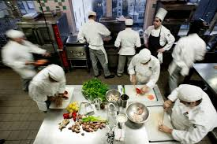
Lesson 1 - Too many cooks in the kitchen
Issue: Working with multiple team members on the same problem can cause issues.
Solution: Divide work amongst multiple teammates.
Lesson: Too many people working on the same item can lead to a conflict in opinions or design considerations that can lead to no work getting done.
Notes:
Andres

Slide 15

Lesson 2 - Dividing work evenly
Issue: Trying to divide work evenly to ensure every member of a group contributes equally.
Solution: Diving tasks to each group member to allow everyone to work independently and get work done efficiently.
Lesson: It is almost impossible to divide work evenly in most cases because some work takes longer than others. So, if there are multiple projects assign the difficult task to different people.
Notes:
Andres

Slide 16
Lesson 3 - Communication is key
Issue: Trying to do work but no one knows what work is being done.
Solution: Communicate with your team and make sure everyone knows what you are doing.
Lesson: Often times teams will do repeated work because of a lack of communication. Knowing what you are doing and telling your team is an important part of being a group member. Since if everyone knew what others were doing then there wouldn’t be repeated or wasted work.
Notes:
Andres

Slide 17

Secret for Success 1 | Start Early
Start assignments early, breaking down assigned roles and work distribution.
Establish foundational elements such as a shared repository, formatting standards, and communication channels.
Allocate time for unexpected challenges and technical issues.
Notes:
David

Slide 18

Secret for Success 2 | Follow Agile Practices
Organize work through the use of Jira boards.
Regularly update a backlog of tasks, prioritizing those with the greatest impact.
Update tasks early and often.
Notes:
David

Slide 19
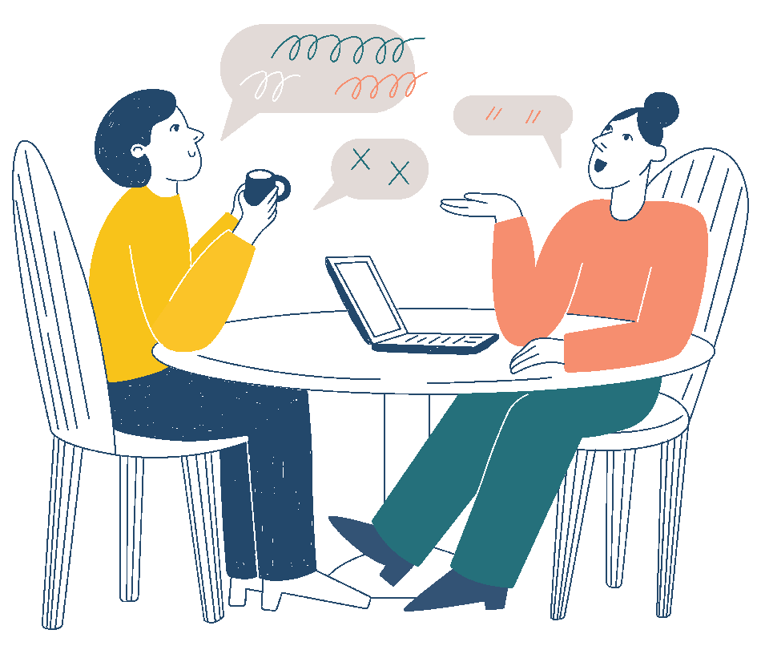
Secret for Success 3 | Communicate Problems
Share issues as soon as they arise to avoid bottlenecks and delays.
Use established communication channels and jira board to document and discuss challenges.
Foster a culture where team members are comfortable asking for assistance or modifying proposed solutions.
Notes:
David

Slide 20

Notes:
David

